Slide 1
Availability of Indicators to Support the New Framework for the Post-2015 Agenda
The case of Cambodia
CountryData Workshop: Building better dissemination systems
for national development indicators
Hotel Camdiana, Phnom Penh, Cambodia
21-25 April 2015
Lay Chhan
National Institute of Statistics
Cambodia

Slide 2
Content
The selected goals :
  7. Secure Sustainable Energy
  8. Create Jobs, Sustainable Livelihoods, and equitable Growth
  9. Manage Natural Resource Assets Sustainably
  10. Ensure Good Governance and Effective Institutions
  11. Ensure Stable and Peaceful Societies

Slide 3
7. Secure Sustainable Energy
Target | Current Status on availability of data/Indicators from National Statistical System
 | High | Medium | Low
7a. Double the share of renewable energy in the global energy mix |  | Survey Data: National Institute of Statistics (NIS) through annual Cambodia Socio-Economic Survey (CSES). Data on types of energy sources used by households (energy consumption by households) Admin data: Ministry of Mine and Energy (data on energy production)
7b. Ensure universal access to modern energy services |  | Admin data: Ministry of Mine and Energy; Ministry of Land Management, Urban Planning and Construction.
7c. Double the global rate of improvement in energy efficiency in buildings, industry, agriculture and transport |  |  | Indicators to support this target may not applicable or not available
7d. Phase out inefficient fossil fuel subsidies that encourage wasteful consumption |  | Admin data: Ministry of Environment and Ministry of Economy and Finance

Slide 4
8. Create Jobs, Sustainable Livelihoods, and equitable Growth
Target | Current Status on availability of data/Indicators from National Statistical System
 | High | Medium | Low
8a. Increase the number of good and decent jobs and livelihoods by x 2 |  | Survey Data: National Institute of Statistics (NIS) through Cambodia Labor Force Survey and CSES. Admin data: Ministry of Labor and Vocational Training
8b. Decrease the number of young people not in education, employment or training by x% | Survey Data: National Institute of Statistics (NIS) through annual Cambodia Socio-Economic Survey, Labor Force Survey and Population Census Admin data: Ministry of Education, Youth and Sport, and Ministry of Labor and Vocational Training
8c. Strengthen productive capacity by providing universal access to financial services and infrastructure such as transportation and ICT |  | Survey Data: National Institute of Statistics (NIS) through annual Cambodia Socio-Economic Survey Admin data: Ministry of Economy and Finance, Ministry of Rural Development, Ministry of Public Work , Ministry of Post and Telecommunication and National Bank of Cambodia
8d. Increase new start-ups by x and value added from new products by y through creating an enabling business environment and boosting entrepreneurship |  |  | Admin data: Ministry of Economy and Finance, Council for Development of Cambodia and National Bank of Cambodia

Slide 5
9. Manage Natural Resource Assets Sustainably
Target | Current Status on availability of data/Indicators from National Statistical System
 | High | Medium | Low
9a. Publish and use economic, social and environmental accounts in all governments and major companies |  |  | Admin data: Ministry of Economy and Finance , and Council for Development of Cambodia
9b. Increase consideration of sustainability in x% of government procurements |  |  | Admin data: Ministry of Economy and Finance , and Council for Development of Cambodia
9c. Safeguard ecosystems, species and genetic diversity | Admin data: Ministry of Agriculture, Forestry and Fisheries, Ministry of Environment
9d. Reduce deforestation by x% and increase reforestation by y% | Admin data: Forestry Administration of Ministry of Agriculture, Forestry and Fisheries
9e. Improve soil quality, reduce soil erosion by x tonnes and combat desertification |  | Admin data: Ministry of Agriculture, Forestry and Fisheries

Slide 6
10. Ensure Good Governance and Effective Institutions
Target | Current Status on availability of data/Indicators from National Statistical System
 | High | Medium | Low
10a. Provide free and universal legal identity, such as birth registrations | Admin data: Ministry of Interior (e.g. vital statistics and birth registration programme)
10b. Ensure people enjoy freedom of speech, association, peaceful protest and access to independent media and information | Admin data: Ministry of Interior and Ministry of Information
10c. Increase public participation in political processes and civic engagement at all levels | Admin data: Ministry of information and Ministry of Information
10d. Guarantee the public’s right to information and access to government data |  | Survey Data: National Institute of Statistics (NIS): Censuses, surveys and administration data system Admin data: Ministry of Information and Council of Ministers
10e. Reduce bribery and corruption and ensure officials can be held accountable |  | Admin data: Anti-Corruption Unit (ACU)

Slide 7
11. Ensure Stable and Peaceful Societies
Target | Current Status on availability of data/Indicators from National Statistical System
 | High | Medium | Low
11a. Reduce violent deaths per 100,000 by x and eliminate all forms of violence against children |  | Survey Data: National Institute of Statistics (NIS) through Cambodia Labor Force and Child Labor Survey. Admin data: Ministry of Women Affairs and Ministry of Social Affairs
11b. Ensure justice institutions are accessible, independent, well-resourced and respect due-process rights |  | Admin data: Ministry of Justice (e.g. Legal and Judicial Reform Strategies)
11c. Stem the external stressors that lead to conflict, including those related to organised crime |  |  | Survey Data: National Institute of Statistics (NIS): Surveys & Censuses Admin data: Ministry of Interior, Ministry of Women Affairs and National Authority on Combating Drug
11d. Enhance the capacity, professionalism and accountability of the security forces, police and judiciary |  |  | Admin data: Ministry of Interior and Ministry of National Defense

Slide 8
Conclusion
Good coordination within NSS
  Statistics Advisory Council (SAC)
  Statistics Coordination Committee (SCC)
  National Statistical Development Strategy (NSDS)
Integrated NSS in the region and the world (e.g ASEANstats)
Strong commitment of the Royal Government
  Launching Rectangular Strategy Phase III in 2013 and strong links to Post-2015 development agenda/SDGs
  National Strategic Development Plan Update 2014-2018, which is a live document with includes set of indicators, including MDGs as key framework for monitoring & evaluation the progress
  Sectoral Development Policies/Strategies (e.g. Education Strategic Plan, Health Sector Development Plan and Green Growth Strategy)

Slide 9
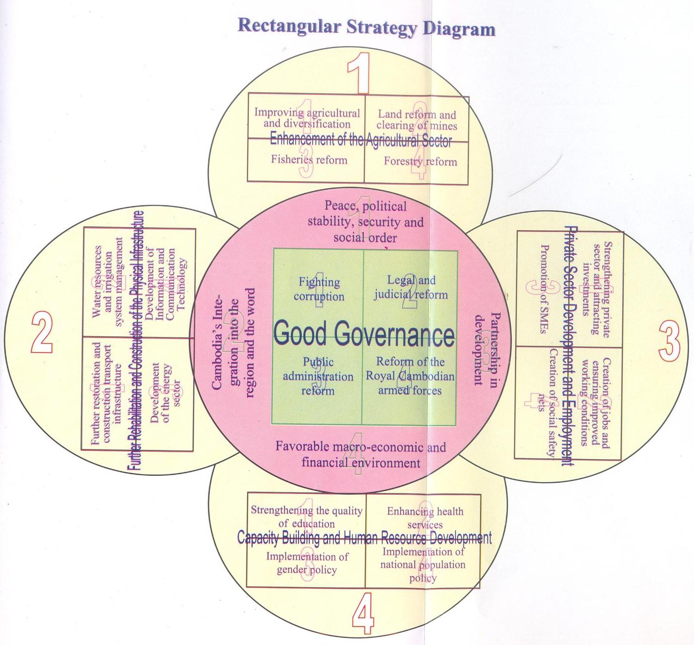
Example: Rectangular Strategy
Source: RGC Rectangular Strategy, Phase III

Slide 10
Thank you!

